Slide 1
Conversion Of Whisper To Normal Speech
Presentation by
K Ramnath
K Rohith Gupta
Guide : Dr. P. Vijayalakshmi
Sri Sivasubramaniya Nadar College of Engineering

Slide 2
Objectives And Motivation
  Study the properties of whisper and normal speech
  Classification of whisper and normal speech
  Conversion for whisper to normal speech
Notes:
Student Notes:
The objective of the session is to introduce the concept of time varying signals and how these signals are described and classified further. We will also discuss various types of other classifications with examples.

Slide 3
Problem Statement
Speech is the most natural and powerful form of communication among humans.
Silent speech interfaces have started to attract attention for new speech communication styles .
Study the traits of whispered and normal speech spectrograms and finding what exactly differs in a whispered speech from normal speech, this piece of information can be a feature used for conversion.
However, conversion of whispered speech to normal speech is difficult because some information is obscured or missing in whispered speech. A major problem is that distinct pitch, tone height, lack of fundamental frequency (Fo) is not maintained in whispered speech.

Slide 4
Significance And Applications
Therefore, current trend lies on developing silent speech interfaces. And to achieve this we suggest to focus on Non-Audible-Murmur (NAM) and Whisper Speech.
The patients who are suffering from the vocal fold paralysis, neurological disorders etc. may not be able to produce normal speech due to the partial or complete absence of vocal fold vibrations (i.e., voicing).
Furthermore, interesting applications of the whispered speech communications are, solving crime scenes as people be in disguise have conversations by whispering.

Slide 5
Literature Review
AUTHOR | TITLE OF THE PAPER | INFERENCE
Takuhiro Kaneko, Hirokazu Kameoka, Kou Tanaka, Nobukatsu Hojo | Maskcyclegan-vc: Learning Non-parallel Voice Conversion With Filling In Frames | Paper concluded that using maskcyclicGAN yielded better results for non parallel voice coversion
Feng Rong | Audio classification method based on machine learning | The paper designed an efficient audio classification algorithm based on SVM using MFCC features

Slide 6
Software Requirements
Python
Tensorflow
Wavesurfer
Librosa

Slide 7
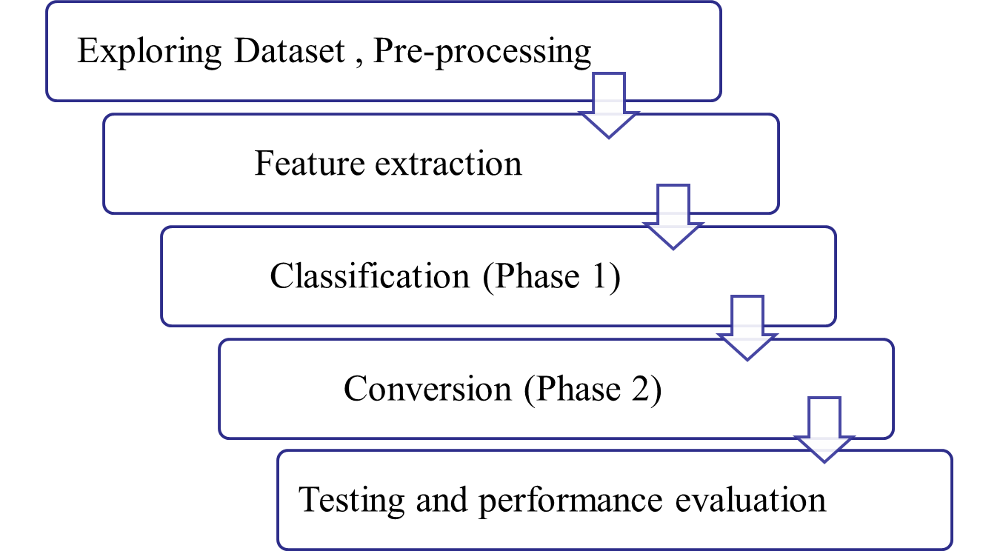
Methodology

Slide 8
Dataset Description
Dataset : wTimit
The dataset is sectioned into training and test segments. It consists of speech samples collected from a corpus of 48 volunteers.
Facts based on speakers demographics:
  Gender is unbiased.
  Speakers belong to the age group of 15-50; the average age of a candidate is 25-30.
  Out of 48 participants- 20 are from Singapore and the rest 28 are from the United States.
  Few Singaporean candidates have mandarin, malayalam, japanese or german accent.
  Similarly, candidates based from the US have multiple accents, majorly spanish, french and german.
Each speaker has contributed 450 sentences; 423 sentences for training and 27 sentences for testing. Sentences used for testing purposes are unique.
Total duration of audio files:
  Singaporean candidates- 22 hr 15 mins 22 sec
  US candidates- 31 hr 06 mins 38 sec

Slide 9
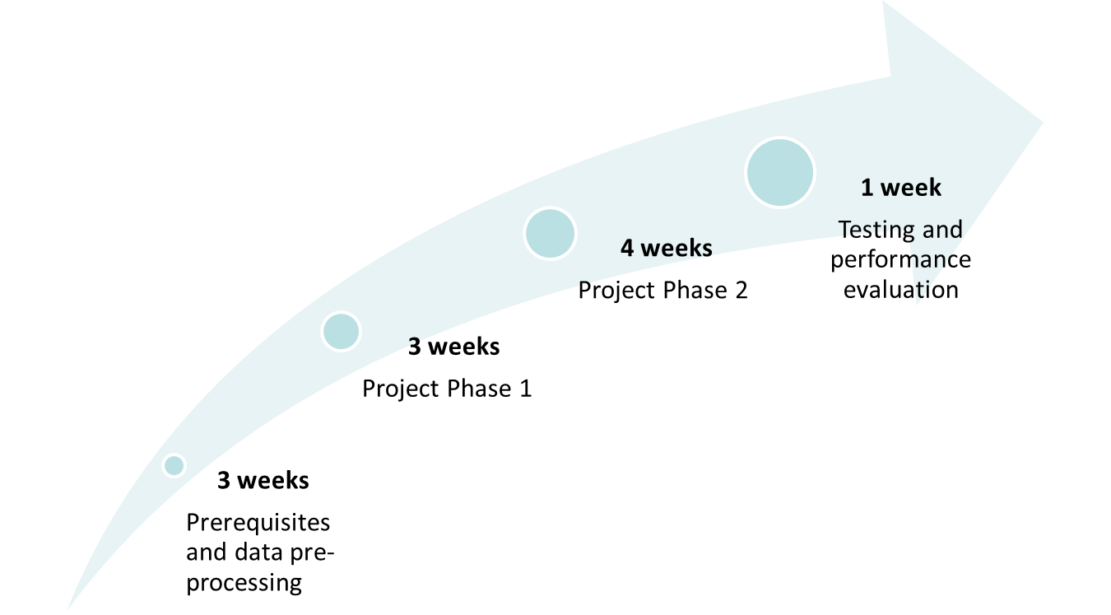
Timeline

Slide 10
References
[1] Takuhiro Kaneko, Hirokazu Kameoka, Kou Tanaka, Nobukatsu Hojo,“Maskcyclegan-vc:Learning Non-parallel Voice Conversion With Filling In Frames”. arXiv:2102.12841v1.
[2] Feng Rong, “Audio classification method based on machine learning” ,ieeexplore.ieee.org/document/804711
[3] Jing-Xuan Zhang, Zhen-Hua Ling, Li-Juan Liu, Yuan Jiang, and Li-Rong Dai,“Sequence-to-sequence acoustic modeling for voice conversion,” IEEE/ACMTransactions on Audio, Speech, and Language Processing, vol. 27, no. 3, pp. 631–644, 2019.

